Slide 1
PART TWO
FASHION & INTERIOR DESIGN
DUDS TO DAZZLE

Slide 2
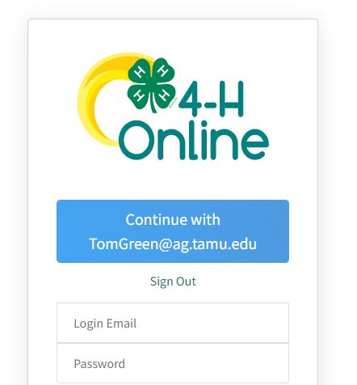
Reminder
In order to participate in ANY 4-H related activities, you MUST be enrolled in 4-HOnline prior to competing or participating.
Adults we also ask that you register via 4-HOnline as well.
HTTPS://V2.4HONLINE.COM/#/USER/SIGN-IN

Slide 3
Deadlines
County Contest
District Contest
Contest Date
March 3, 2024 | 4-H Building
Registration Deadline
February 23, 2024
Via County Webpage
You must participate in the county to compete in the district contest.
Contest Date
March 26 | Llano, TX
Registration Deadline
March 11, 2024
Via 4-HOnline
You must participate in the county to compete in the district contest.

Slide 4
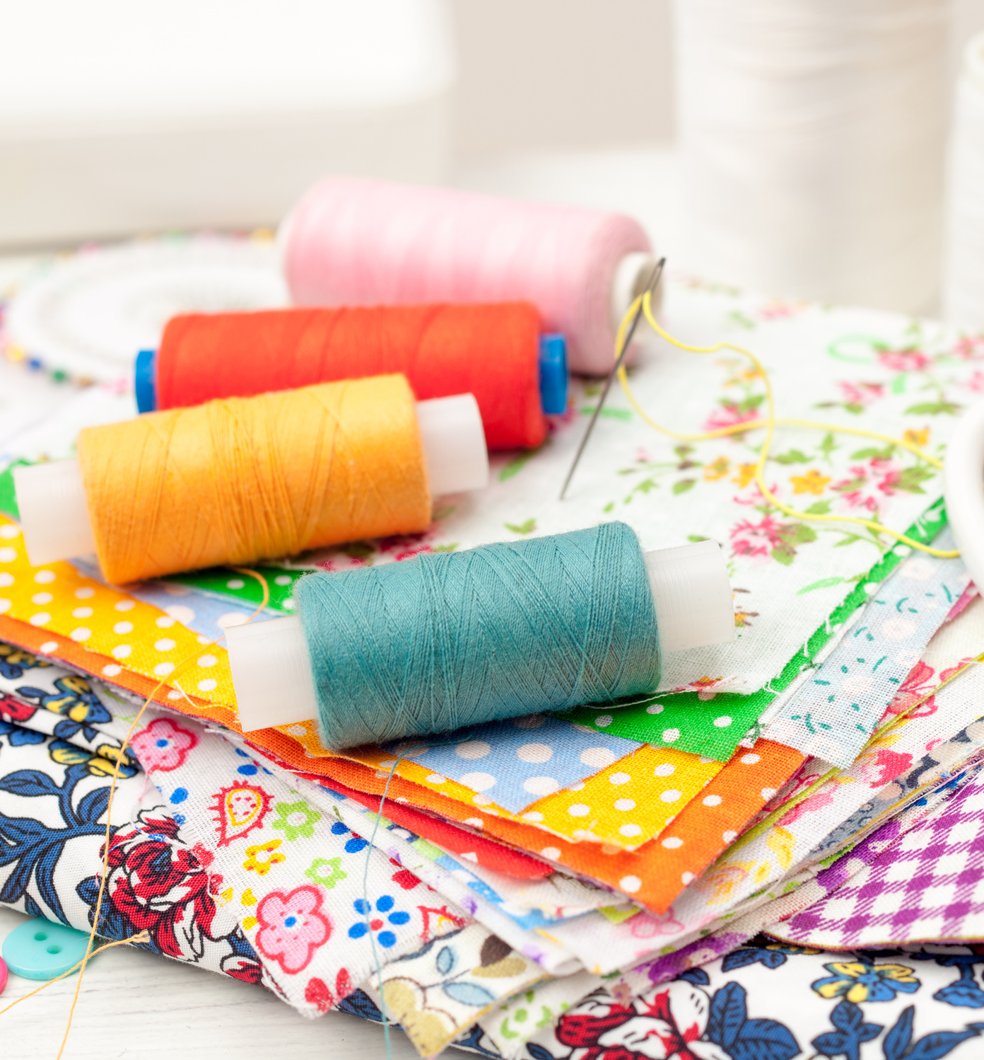
Who Can Compete?
Juniors
3rd - 5th Grade
Intermediates
6th - 8th Grade
Seniors
9th - 12th Grade
DUDS TO DAZZLE 2024

Slide 5
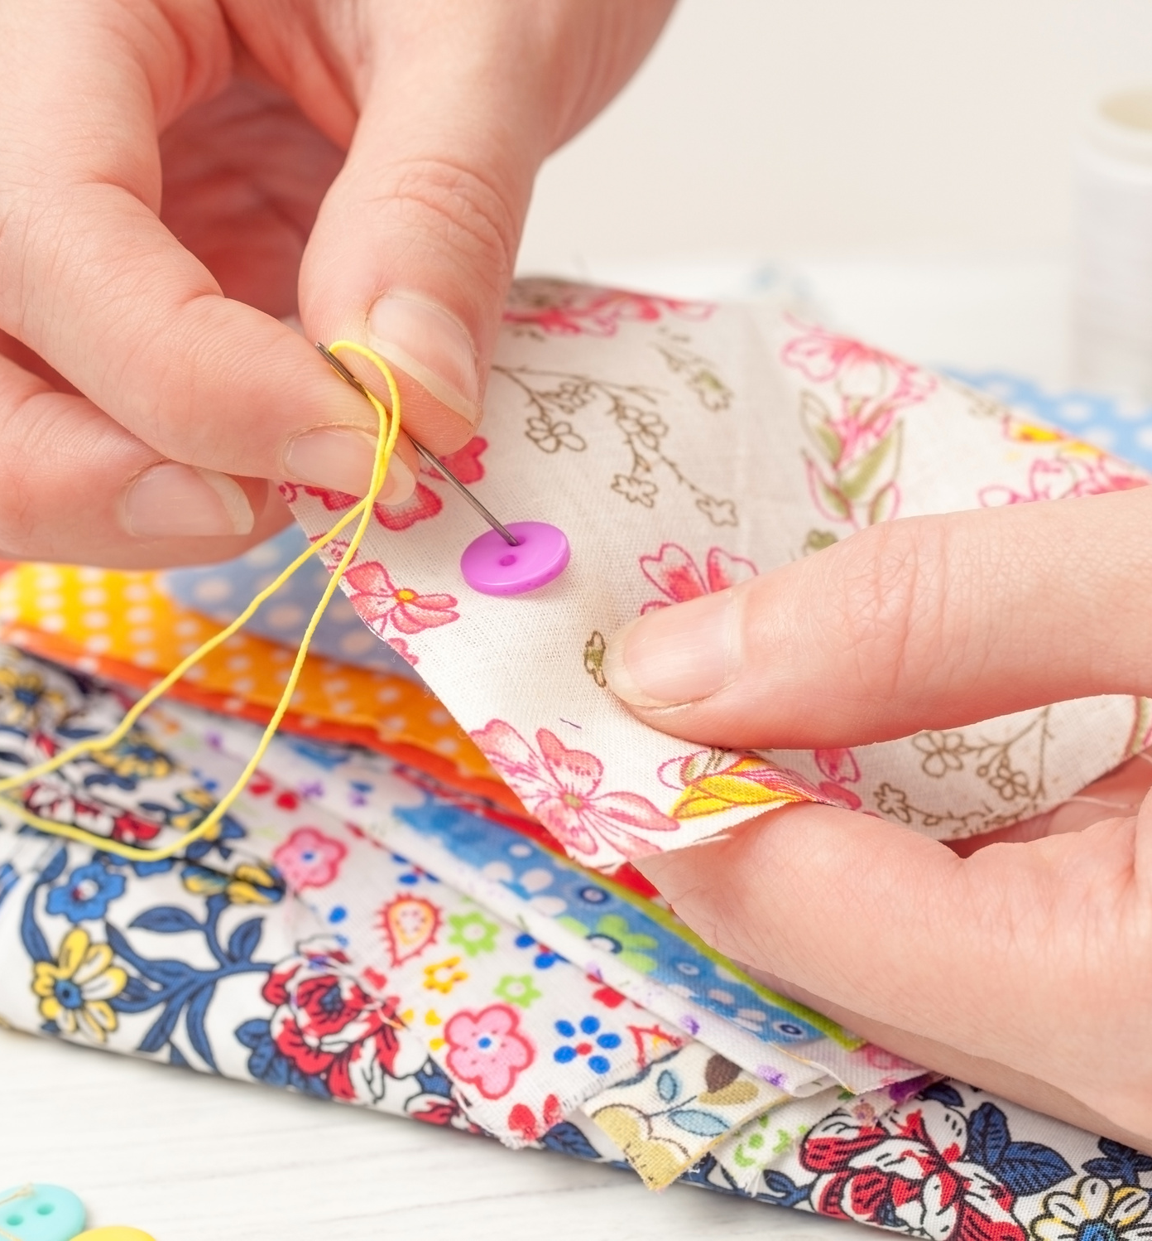
Major Changes
Contest objectives have changed to include the environmental impacts of the fashion industry.
“How does fast fashion affect the environment?” has been added to the list of contest resources.
Team size has changed from 3-5 to 3-4
Teams must use 2 items from the “closet”
Foam paint brushes and Mod podge have been deleted from the sewing kit.
Duds to Dazzle Score Sheet has been revised. Team preparation 45% and team presentation 55%. There is more emphasis on the quality and overall appearance of the final product.
DUDS TO DAZZLE 2024

Slide 6
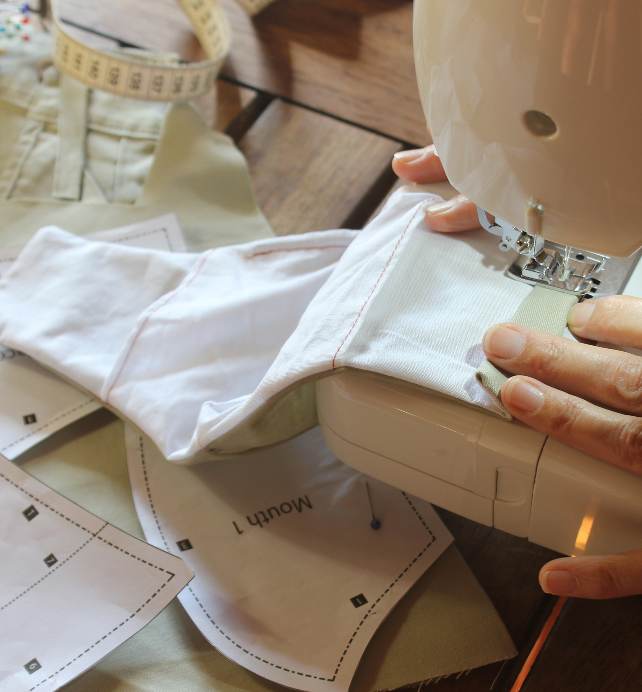
The Basics
TEAMS
3-4 Members
TIMEFRAME
60 minutes | Construction and Clean-up
CONTEST RESOURCES
­Unraveling the Mystery of Design Elements and Principles in Clothing, Laundry on Your Own, Hemstitching, Pricing Tips and Tricks, Safety Guide, and Simple Seaming Techniques & Presentation worksheet
START-UP ITEM
One item given to each team
CLOSET ITEMS
Additional items to add to start-up item.
DUDS TO DAZZLE 2024

Slide 7
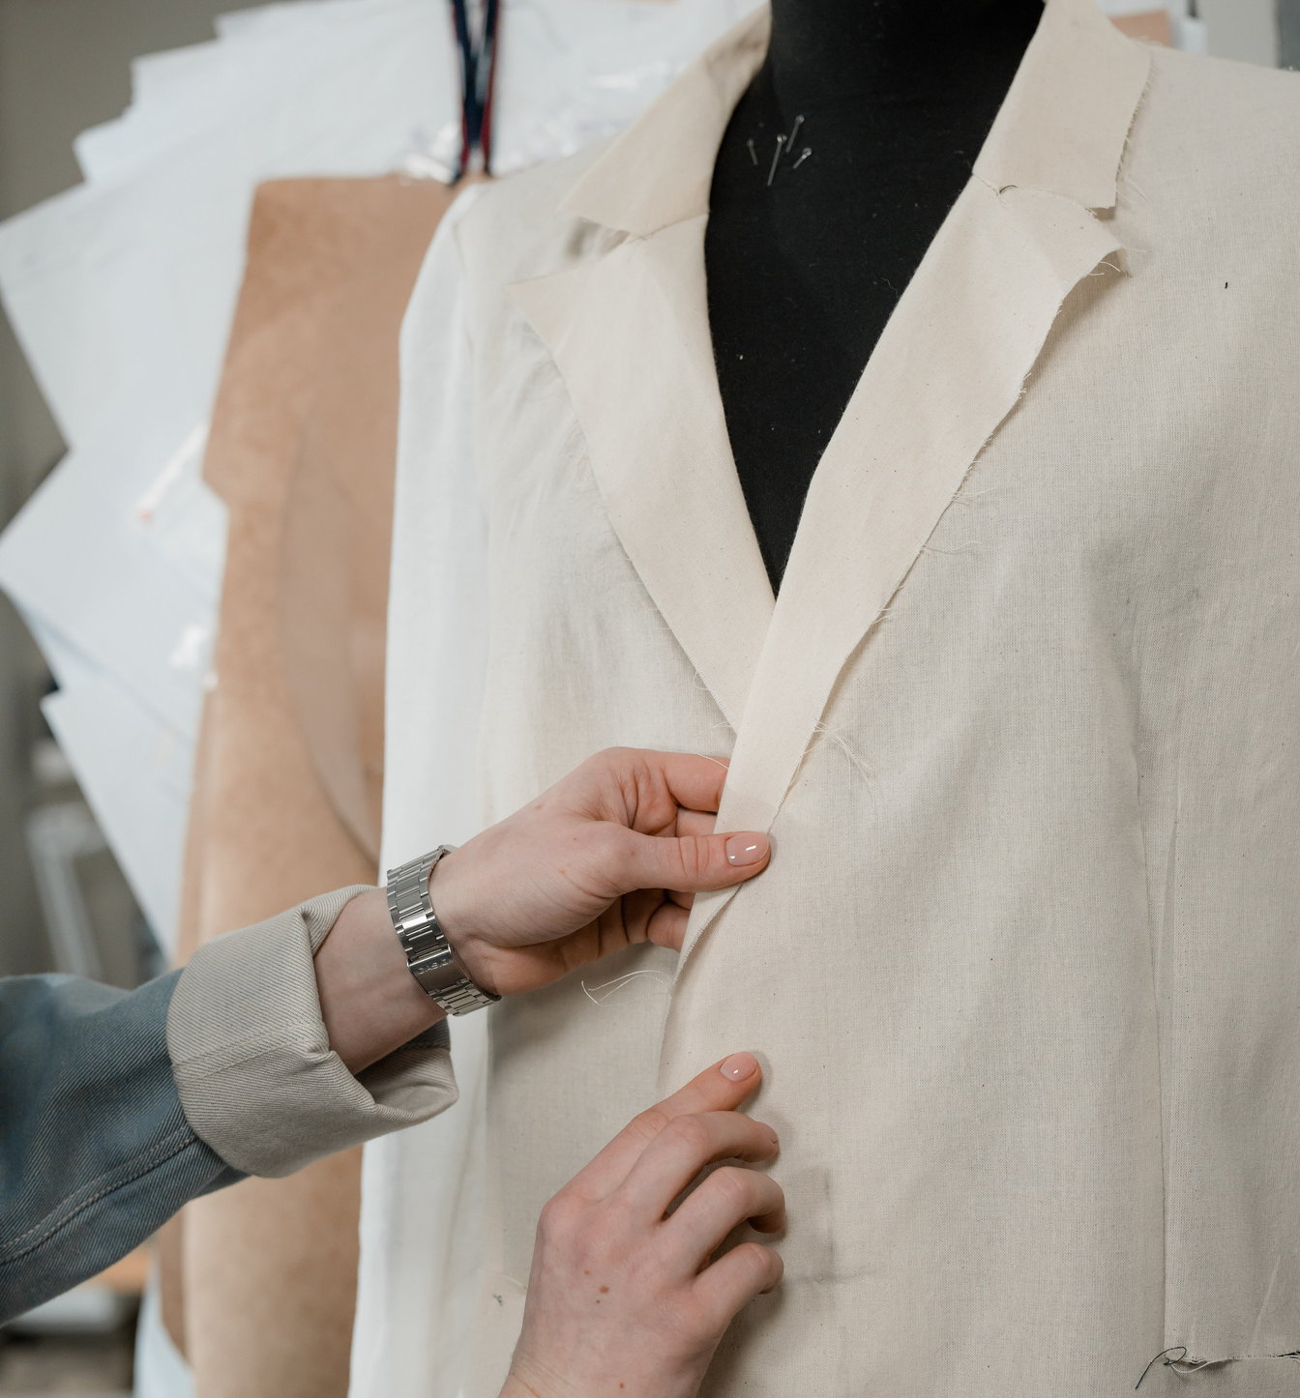
Resource Materials
A Planning and Presentation Worksheet will be provided for each team at the contest.
The below resources should be used at practice ONLY
Unraveling the Mystery of Design Elements and Principles in Clothing
Laundry on Your Own
Hand Stitching
Pricing Tips and Tricks
Safety Guide
Simple Seaming Techniques
How Does Fast Fashion Affect the Environment?
DUDS TO DAZZLE 2024

Slide 8
Category Descriptions
Wearable
Accessory/Jewelry
Non-wearable
Clothing that is suitable to be worn by people or pets.
Ex: shirt, coat, vest, dress, costume, leggings, swimsuit cover, etc.
An article or set of articles that can be added to an outfit to make it more useful, versatile, or attractive.
Ex: apron, earrings, purse, headband, hat, belt, necklace, etc.
An item that is not suitable to be worn.
Ex: pillow, towel, jewelry
pouch, cellphone or iPad case, stuffed animal, doll clothes, Christmas stocking,

Slide 9
Sewing Kit
Each team will bring a sewing kit containing only one each of the following items, unless a different quantity is noted.
A team can choose not to include a listed item, but no additional item can be added. A team may organize their kit by utilizing a storage container of choice.
DUDS TO DAZZLE 2024

Slide 10
Preparation & Clean Up
60 minutes to construct an item, plan a presentation, and clean up.
Minimum of 50% of the visible final product MUST include the start-up item.
Closet Items
Teams are judged during this time.
Clean up is included in prep-time.
Only "HOT" items will be allowed to remain in the construction area (iron, glue gun, etc.)
DUDS TO DAZZLE 2024

Slide 11
Presentation
Each teammate must participate in the presentation with at least three having speaking roles.
Time Limits:
Presentation: 5 minutes
Questions: 3 minutes
DUDS TO DAZZLE 2024

Slide 12
Score Card
To get full points in prep and presentation please take a look at the score card.
Point amounts have changed since 2023
DUDS TO DAZZLE 2024

Slide 13
Questions?
(325)659.6522
hayley.meyer@ag.tamu.edu
https://tomgreen.agrilife.org/4h/

