Slide 1
PART ONE
FASHION & INTERIOR DESIGN
FASHION SHOW

Slide 2
Reminder
In order to participate in ANY 4-H related activities, you MUST be enrolled in 4-HOnline prior to competing or participating.
Adults we also ask that you register via 4-HOnline as well.
HTTPS://V2.4HONLINE.COM/#/USER/SIGN-IN

Slide 3
Deadlines
County Contest
District Contest
Contest Date
March 4, 2024 | 4-H Building
Registration Deadline
February 23
Via County Webpage
You must participate in the county to compete in the district contest.
Contest Date
March 26 | Llano, TX
Registration Deadline
March 11, 2024
Via 4-HOnline
You must participate in the county to compete in the district contest.

Slide 4
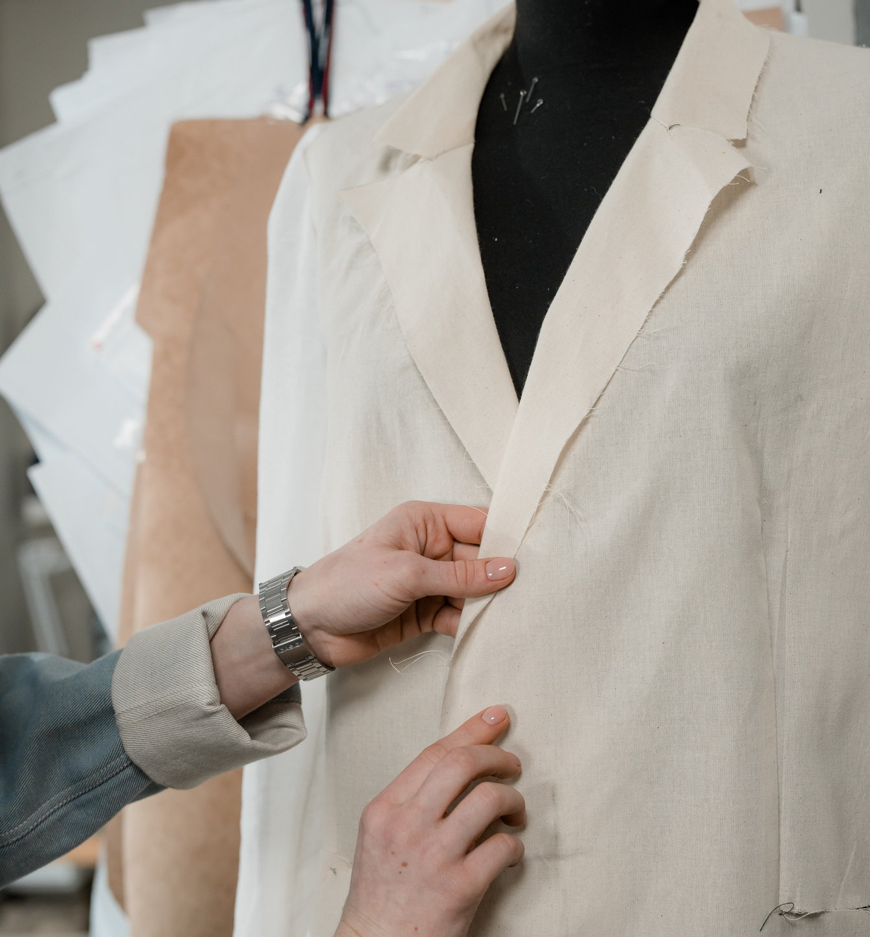
Who Can Compete?
Clover Kids
Kinder - 2nd Grade
Juniors
3rd - 5th Grade
Intermediates
6th - 8th Grade
Seniors
9th - 12th Grade
FASHION SHOW 2024

Slide 5
Available Contest
Fashion Show | Fashion Storyboard | Crafted Items
Age Divisions Allowed:
Clover Kids
Juniors
Intermediates
Seniors
Divisions:
Buying
Construction
Natural Fibers
Allowed ONE entry
Age Divisions Allowed:
Clover Kids
Juniors
Intermediates
Seniors
Digital Submission Only
Theme: “Dream”
Allowed ONE entry
Age Divisions Allowed:
Clover Kids
Juniors
Intermediates
Seniors
Categories:
Embellished Apparel
Jewelry Making
Non-Apparel
Allowed ONE entry

Slide 6
FASHION SHOW

Slide 7
BUYING DIVISION
Subcategories
BUSINESS & INTERVIEW ATTIRE
FANTASTIC FASHIONS UNDER $25
SEMI-FORMAL TO FORMAL
SPECIAL INTEREST
FASHION SHOW 2024

Slide 8
Category Descriptions
Business & Interview Attire | Fantastic Fashions Under $25 | Semi-formal to Formal | Special Interest
Outfit worn for job interview, scholarship interview, job fair, professional event.
Can be professional or business casual.
Outfits must be purchased at a garage sale, consignment store, etc.
Receipts are required for everything visible during interview except shoes.
Must be designed for semi-formal to formal occasions and made from fabrics intended for the same.
Entry should be a specific outfit that you need to know how to purchase wisely.
Entry should be something that reflects a special interest.

Slide 9
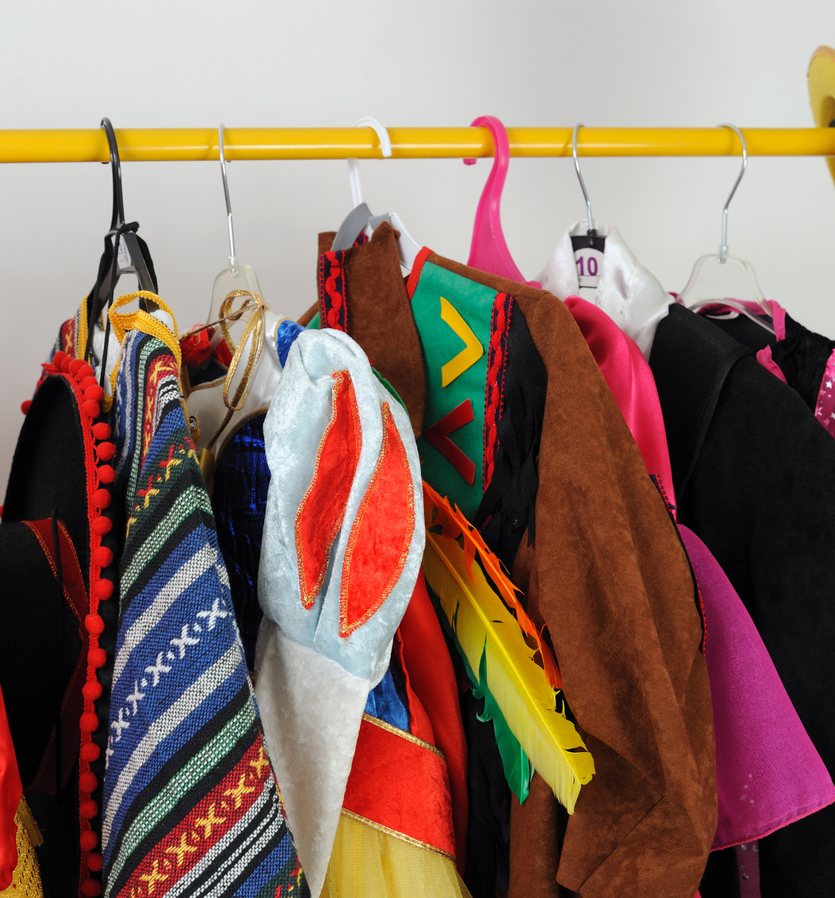
CONSTRUCTION DIVISION
Subcategories
EVERDAY LIVING
REFASHION
SEMI-FORMAL TO FORMAL
THEATRE/COSTUME
FASHION SHOW 2024

Slide 10
Category Descriptions
Everyday Living | ReFashion | Semi-formal to Formal | Theatre/Costume
Includes casual sportswear, weekend wear, sleepwear, clothing for school, casual afterschool events, hanging out with friends.
Outfits must be modified from an existing clothing or fabric item into something more fashionable.
Must be designed for semi-formal to formal occasions and made from fabrics intended for the same.
Garment intended for use as a costume, which would include stage production. May be sewn from fabric or from another garment.

Slide 11
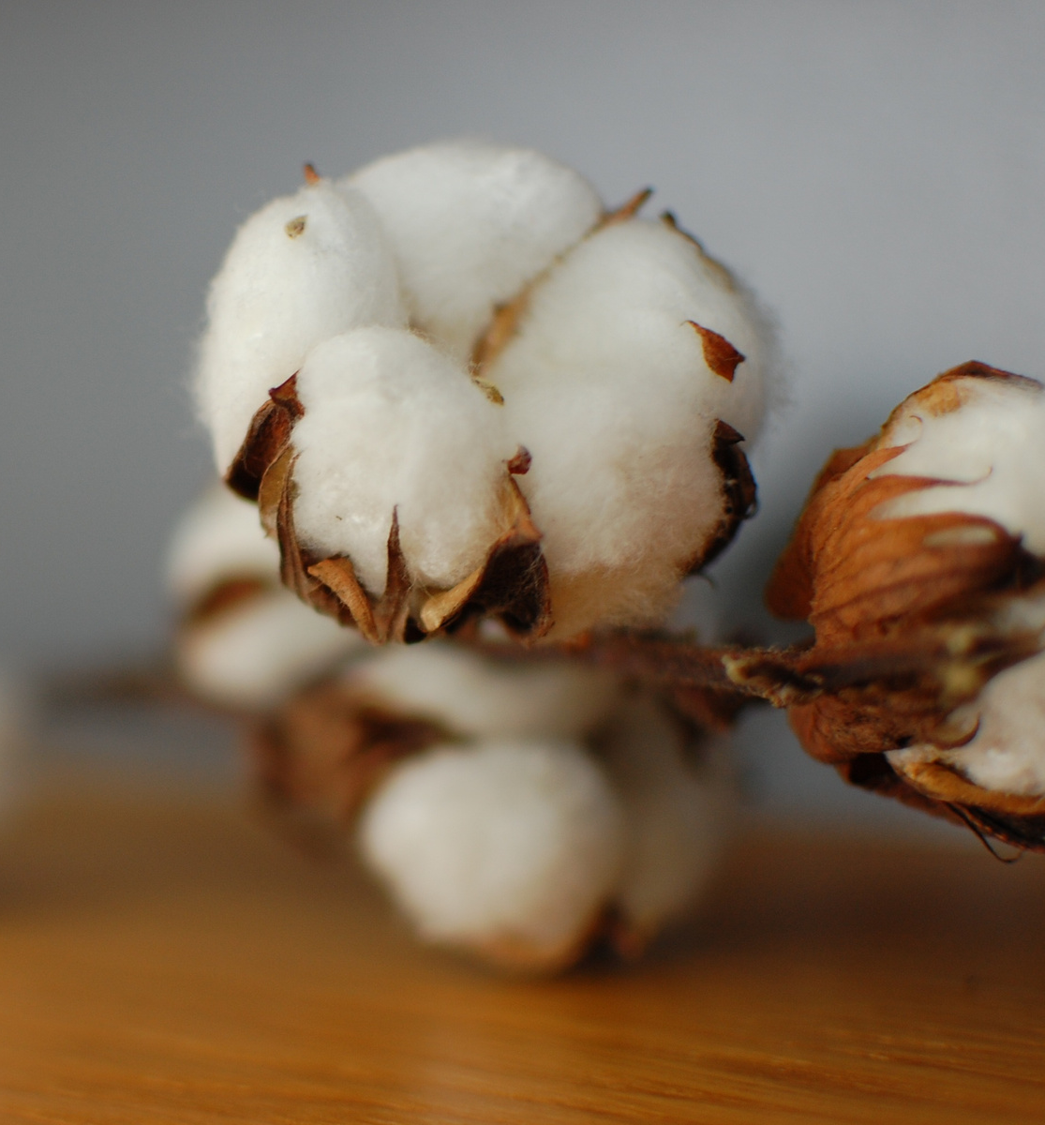
NATURAL FIBER DIVISION
Subcategories
COTTON
WOOL/MOHAIR/ALPACA
FASHION SHOW 2024

Slide 12
Category Description
Cotton
Wool/Mohair/Alpaca
Each garment must contain a minimum of 60% cotton.
Knowledge of fiber characteristics, production, and end-use.
Each garment must contain a minimum of 60% wool and 40% other fiber
60% mohair and 40% other fabric
60% blend of two fibers and 40% other fiber
100% wool/mohair blend is also acceptable
Knowledge of fiber characteristics, production, and end-use.

Slide 13
Parts of Fashion Show
Interview
Questions
Each contestant will start by introducing themselves and model their garment to the judges.
5-minute presentation to the judges.
Need to describe their project activities, outfit selection, construction or buying skills, and their knowledge of fiber and fabrics.
Judges will have the opportunity to ask each participant questions from the list of contest questions as well as questions related directly to the participant’s garment or project experiences.

Slide 14
FASHION STORYBOARD

Slide 15
Theme: Dream
Design Brief
"Dream" serves as the ultimate source of inspiration for this fashion concept. The concept revolves around the multifaceted nature of dreams, whether they are the surreal visions that captivate a sleeping mind or the vivid aspirations that fuel the conscious soul. The fashion narrative will blur the lines between reality and reverie, creating a visual story that celebrates the ethereal and the tangible. This concept invites designers to translate the essence of dreams into fashion, evoking a sense of wonder, mystery, and endless possibility
FASHION SHOW 2024

Slide 16
Category Descriptions
Wearable | Accessory | Jewelry | Pet Clothing | Home Decor | Home Furnishing
Clothing that can be worn. Includes items such as pants, shorts, skirts, blouses, sweaters, coats, dresses, etc.
Includes items such as belts, purses, bags, hats, etc.
Includes necklaces, bracelets, rings, and earrings.
Includes items that can be worn by a pet or any other animal.
Items that are easy to move and make a home visually appealing, examples of home décor items include: throw pillows, table runner, or wall hanging.
Items that make a home comfortable for living or working in. Examples include: couch, ottoman, chair, tables, desks, beds and the like

Slide 17
Specs
Dimensions need to be between:
18" and 24" (in one direction)
24" and 30" (in the other directions).
Recommended size is 18" by 24".
Digital Entries ONLY
Places to design: Canva, Publisher, Adobe, Powerpoint
FASHION SHOW 2024

Slide 18
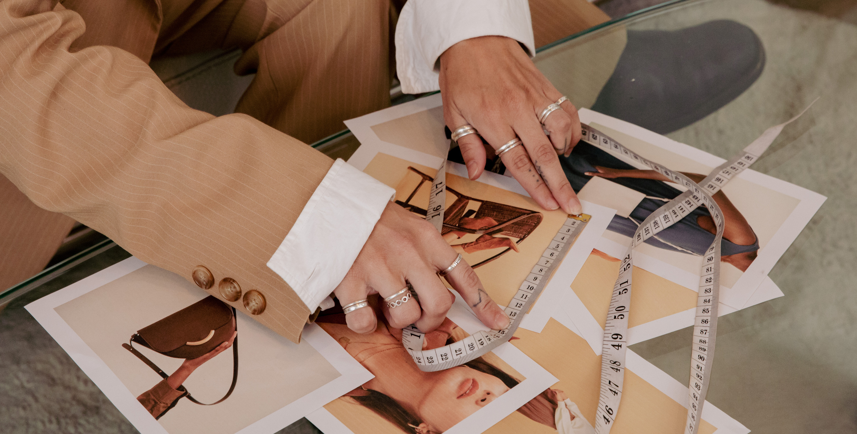
Questions?
(325)659.6522
hayley.meyer@ag.tamu.edu
https://tomgreen.agrilife.org/4h/

